Slide 1
VisualLISA
Behind the Scenes
Universidade do Minho, Departamento de Informática
Nuno Oliveira, 2008

Slide 2
Outline
Introduction
Visual Language Grammar for VisualLISA
DEViL
Implementation
Results
Universidade do Minho, Departamento de Informática
Nuno Oliveira, 2008
1

Slide 3
Introduction
VisualLISA is a project under the UCE-15 of MSc in Informatics’ 2nd year;
VisualLISA is a graphical interface for the compilers-compiler LISA.
VisualLISA will be used to edit visually LISA specifications.
Can’t VisualLISA be a generic VisualAG tool?
Universidade do Minho, Departamento de Informática
Nuno Oliveira, 2008
2
Notes:
Normally, textual programming languages are harder to use then visual ones;
Prog. Languages’ syntax is difficult to learn in a couple of hours;
Syntax errors can take hours to be detected;

Slide 4
Visual Language Grammar
Differences between visual and textual Grammars?
Operators to relate two or more symbols in space;
Attributes to compute symbol’s position;
Notion of order of symbol’s occurrence;
Universidade do Minho, Departamento de Informática
Nuno Oliveira, 2008
3

Slide 5
Visual Language Grammar
(…)
AG_ELEM → LEFT_SYMBOL | NON_TERMINAL | TERMINAL | SYNT_ATTRIBUTE
| INH_ATTRIBUTE | TREE_BRANCH | IV_ATTRIBUTE
| SYNT_CONNECTION | INH_CONNECTION| IV_CONNECTION
(…)
TERMINAL → o v e r ( r e c t a n g l e , t e x t )
(…)
TREE BRANCH → p o i n t s _f r o m ( p o i n t s _t o ( l i n e , ˜TERMINAL) ,
˜LEFT SYMBOL)
| p o i n t s _f r o m ( p o i n t s_ t o ( l i n e , ˜NONTERMINAL) ,
˜LEFT SYMBOL)
4

Slide 6
DEViL – Development Environment for Visual Languages
Bad Aspects
Good Aspects
Complex Installation;
Disperse Documentation and written in German;
Generated Editor is only compatible with the SO where it is Generated;
...
Very good support;
Too much examples, addressing several DEViL features;
Exists for MacOS, Windows and Linux
...
Universidade do Minho, Departamento de Informática
Nuno Oliveira, 2008
5

Slide 7
Implementation
Visual Language Grammar into DEViL Model Representation
Editor Generation
Semantic Analysis
Code Generation
Universidade do Minho, Departamento de Informática
Nuno Oliveira, 2008
6

Slide 8
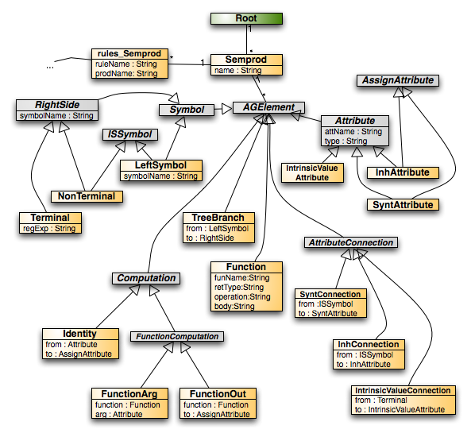
DEViL Model Representation

Slide 9
Editor Generation
Definition of Models to create different views:
Define buttons’ Look & Feel;
Define buttons’ behavior;
...
Definition of Canvas’ Look & Feel:
Assign Visual Patterns to each grammar Symbol or Attribute;
Define computations to implement the Visual Pattern assigned (ex: SYNT.drawing, SYNT.text, ...);
Calculate values for Symbols’ attributes;
Universidade do Minho, Departamento de Informática
Nuno Oliveira, 2008
8

Slide 10
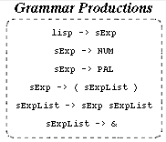
Editor Generation
VIEW rootView ROOT Root {
BUTTON IMAGE "img::btnSemprod"
INSERTS Semprod
INFO "Inserts a new Grammar Production";
}
SYMBOL rootView_Root INHERITS VPRootElement, VPForm
COMPUTE
SYNT.drawing = ADDROF(rootViewDrawing);
END;
SYMBOL rootView_Root_semprods INHERITS
VPFormElement, VPSimpleList
COMPUTE
SYNT.formElementName = "productions";
END;
9

Slide 11
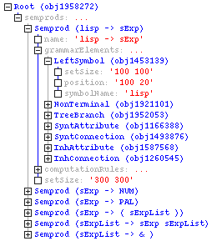
Semantic Analysis
DEViL builds a tree representation for our specification, based on the grammar specified;
DEViL gives us a sort of a tree walker to perform computations given a tree context;
The tree walker is named addCheck
A tree context is any symbol or attribute in the tree representation;
Universidade do Minho, Departamento de Informática
Nuno Oliveira, 2008
10

Slide 12
Semantic Analysis
Semantic Contraint: A production must have one and only one root symbol
checkutil::addCheck Semprod {
set n [llength [c::getList {$obj.grammarElements.CHILDREN[LeftSymbol]}]]
set symbName [c::get {$obj.name.VALUE}]
if { $n == 0 } {
return "Production '$symbName' must have one Root symbol!"
} elseif {$n > 1} {
return "Production '$symbName' must have only one Root symbol!"
}
return ””
}
11

Slide 13
Code Generation
Definition of code templates with IPTG/PTG files;
Definition of code generation using LIDO files:
Use CONSTITUENTS to access/refer to symbols far down on the tree from the actual context;
Use INCLUDING* to access/refer to symbols far up on the tree from the actual context;
Use of SYNT attributes to calculate code or parts of code;
* INCLUDING reduces the need of using inherited attributes;
Universidade do Minho, Departamento de Informática
Nuno Oliveira, 2008
12

Slide 14
Code Generation
bnfProd(lhs, rhs):
[lhs] -> [rhs]
SYMBOL bnfgen_Semprod: bnfLHS : PTGNode;
SYMBOL bnfgen_Semprod: bnfRHS : PTGNode;
SYMBOL bnfgen_Semprod: bnfCode : PTGNode;
SYMBOL bnfgen_Semprod
COMPUTE
SYNT.bnfLHS = CONSTITUENTS bnfgen_LeftSymbol.pers_symbolName
WITH(PTGNode, PTGNewLineSeq, PTGAsIs, PTGNull);
SYNT.bnfRHS = PTGAsIs(VLString(SELECT(vlList(
"printBNFOrderedRHSElements",THIS.objId),eval())));
SYNT.bnfCode = PTGbnfProd(THIS.bnfLHS, THIS.bnfRHS);
END;
13

Slide 15
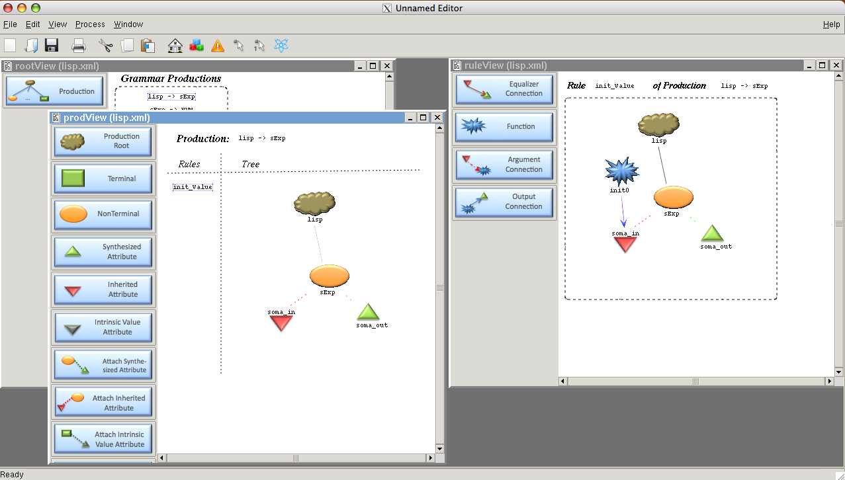
File Dependencies
Symbols.GIF
Viag.XMODEL
images.GDR
Buttons.PNG
View.LIDO
Semantics.TCL
Edit.TCL
Sync.TCL
View.MODEL
Viag.DEFS
Code.IPTG
Code.LIDO
Code.SPECS
Code.MODEL
Code.HEAD
Aux.TCL

Slide 16
The Editor

Slide 17
THE END
Universidade do Minho, Departamento de Informática
Nuno Oliveira, 2008

